Slide 1
My Favorite Paper of All Time
and its use in an l₁–Optimal
Iterative Learning Control Analysis
Kevin L. Moore, Ph.D., P.E.
G.A. Dobelman Distinguished Chair
and Professor of Engineering
Division of Engineering
Colorado School of Mines
CSM Sensing, Communication, and Control Colloquium
September 30, 2008

Slide 2
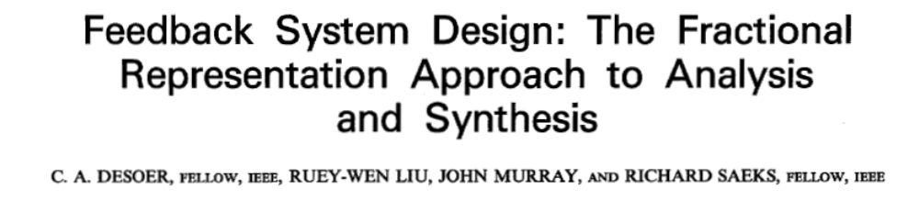
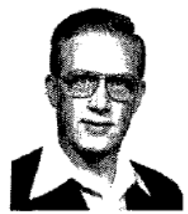
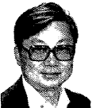
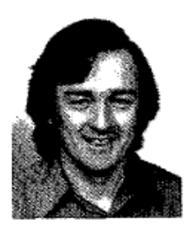
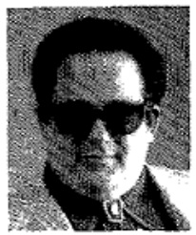
The Epitome of Why I Like Control
Paper showed how the idea of a “… parameterization of the class of all stabilizing controllers …” could be generalized so as to cover a wide range of system classes
Beautiful example of the power of abstraction in control theory

Slide 3
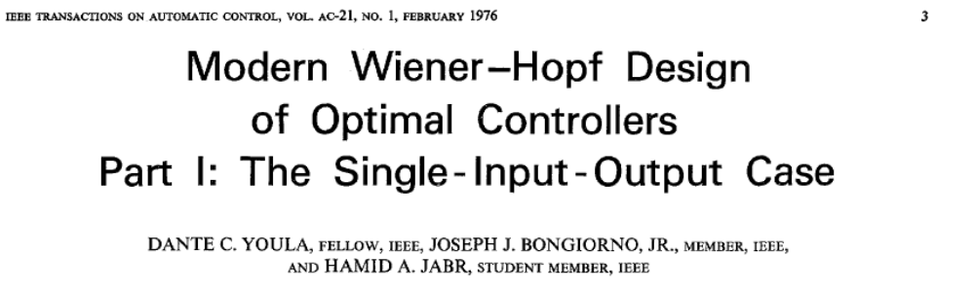
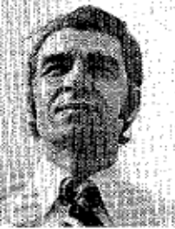
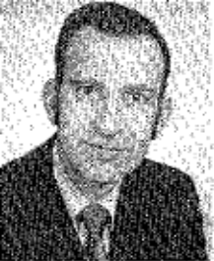
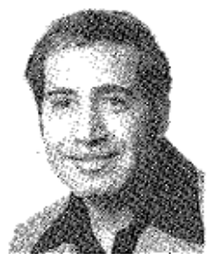
A Bit of History
This paper exploits what is often known as the “Youla parameterization” or sometimes the “YJB parameterization”
  Concern is finding a way to write an equation that contains all possible controllers for a system, as a function of a free parameter
February 1976 result

Slide 4
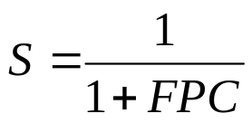


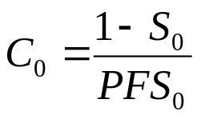
February 1976 YJB Paper
d
e
C
P
+
F
Some assumptions
Optimality measure
First found optimal
Then computed main result

Slide 5
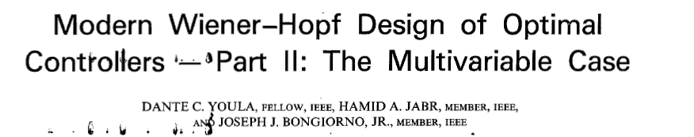

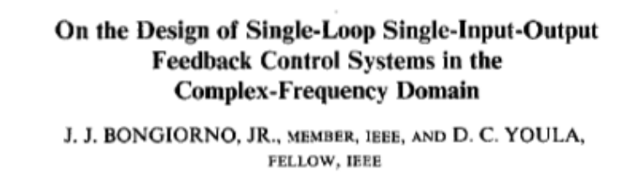

June ‘76 YJB Paper/ June ’77 BY Paper
Considered the MIMO case of the February paper
Obtained as a side result the (MIMO) parameterization of all stabilizing controllers
A, B from the plant
X, Y computed
K anything that is stable
Considered the SISO version of parameterization of all stabilizing controllers

Slide 6
Aside: On Some History in Control Theory
Sometimes people like to think about three periods in the development of control theory:
  Classical period (pre-1960s): Laplace transform-based
    Bode/Nyquist/Nichols ideas
    PID design
  “Modern” period (1960-1980): State space-based
    Controllability/Observability/Optimal state feedback and estimation
    Kalman filtering
  “Neo-Classical” period (post 1980s) (John Doyle term)
    Development of H_\infty
    Unification of ideas from classical and modern periods
  Arguably, the development of the YJB parameterization facilitated the transition to the neo-classical period

Slide 7
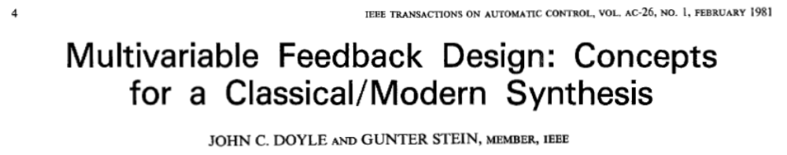
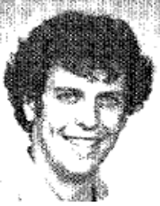
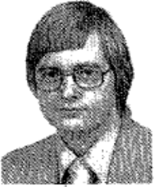
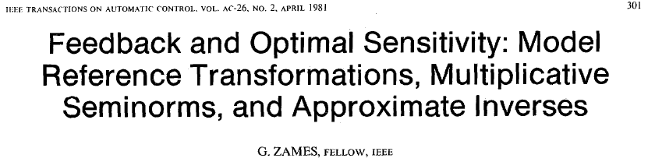
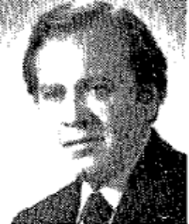
4-8 years following 1977 BY paper were a flurry of activity!
Feb 1981 Doyle/Stein posed the problem of frequency-domain uncertainty in the plant
April 1981 Zames posed the problem of H_\infy optimal control

Slide 8
4-8 years following 1977 BY paper were a flurry of activity!
June 1981 the paper I want to discuss appeared (introducing a ring-theoretic setting)
1985 Vidyasagar solved the H_\infty synthesis problem (in a ring-theoretic setting)
Control System Synthesis: A Factorization Approach
Mathukumalli Vidyasagar

Slide 9

Aside: Of Quotients and Divisors
We will see that the development leads to equations of the form
Given
N, D, X, and Y are real-rational or polynomial matrices
Find
Similar equations have been around a long time (from Vidyasagar):
  Kailath called it the Bezout identity
  Kucera called it the Diophantine equation
    Related to problem of solving for ax+by=1 where a, b, x, y must be integers
    Named in honor of 3 century AD mathematician Diophantus, who appraently never studied the equation
  First occidental mathematician to solve it was Meziriac in 1624 AD
  But, first to find all solutions was an ancient Hindu named Aryabhatta, 476 AD
    Thus should be called Aryabhatta equation

Slide 10

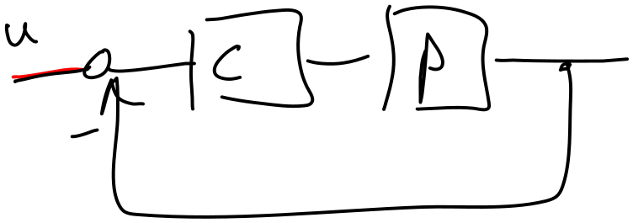

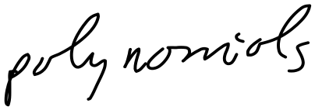
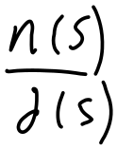
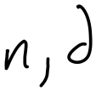




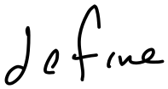
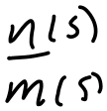


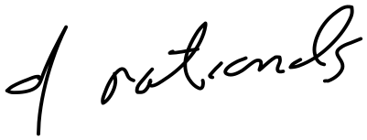


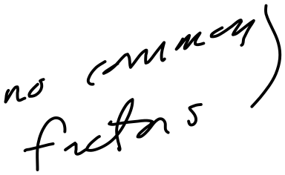

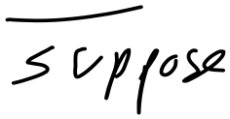



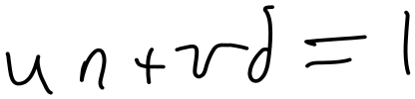




Chalk Talk -1

Slide 11
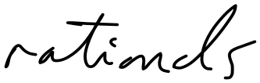






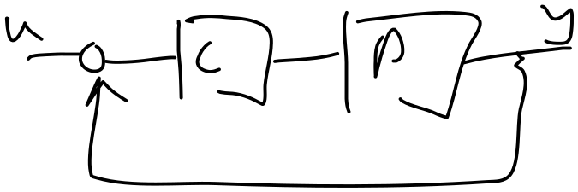
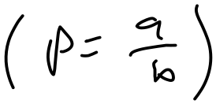
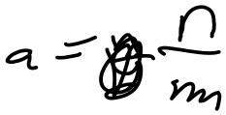

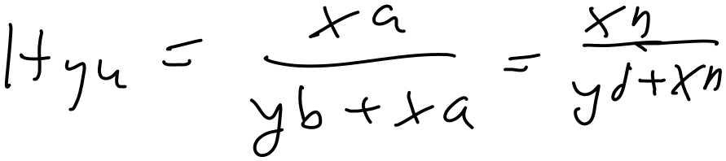
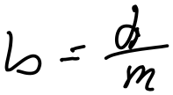

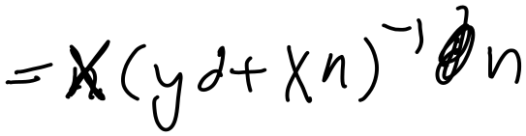
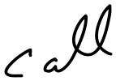




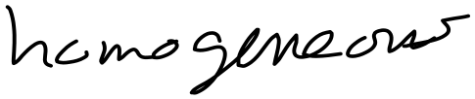
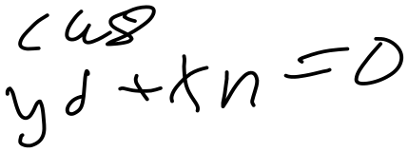
Chalk Talk -2

Slide 12
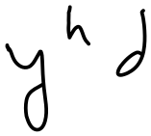


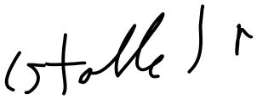
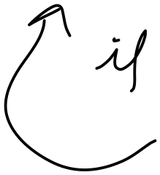
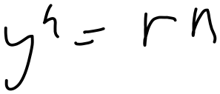



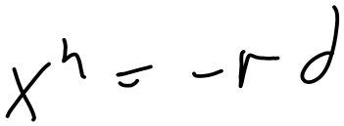
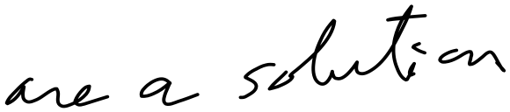

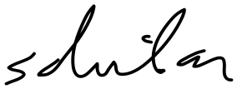
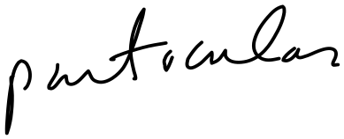


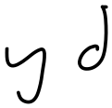





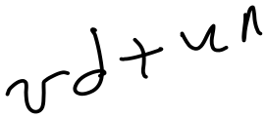





Chalk Talk -3

Slide 13
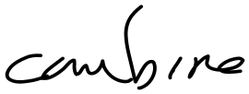
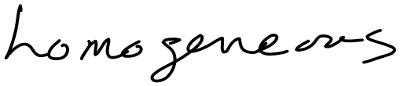
























Chalk Talk -4

Slide 14

























Chalk Talk -5

Slide 15
Chalk Talk -6

Slide 16
Chalk Talk -7

Slide 17
Chalk Talk -8

Slide 18
Chalk Talk -9

Slide 19
Chalk Talk -10

Slide 20
Interlude – Towards Generalizing the Result: Of Groups, and Rings and Things - 1
Set S
Operation “+”
Identity elements w.r.t. “+”
Inverse elements w.r.t. “+”
Associative w.r.t. “+”
Group G=(S,+)
Commutative
Abelian Group G_{a}=(S,+)
Second operation “*”
Associative w.r.t. “*”
Distributive w.r.t. “+” and “*”
Ring R=(S,+,*)
Identity
Ring with Identity R=(S,+,*)
Etc.
Etc.

Slide 21

Interlude – Towards Generalizing the Result: Of Groups, and Rings and Things - 2
A little more framework:
For example:
  G = {set of all proper rational functions n(s)/d(s)}
  H = {set of all stable rational functions n(s)/d(s)}
  I = {set of all stable rational functions n(s)/d(s) that are not strictly proper (e.g.,
  systems with relative degree=0}
  J = {set of all stable rational functions n(s)/d(s) with relative degree=0 whose
  zeros are stable (e.g., stable, relative degree zero, minimum phase systems}

Slide 22


Interlude – Towards Generalizing the Result: Of Groups, and Rings and Things - 3
And just a little more framework for

Slide 23




Well-posedness
Stable
Relative deg.=0
Stable zeros
Stable
Relative deg.=0
Stable
All transfer functions

Slide 24


Cutting to the Chase

Slide 25

Why this is so nice
Because it applies to any ring with identity, many of which we encounter regularly
Captures continuous and discrete

Slide 26




Examples from the paper

